Slide 1


1/30
Politecnico of Turin
Master Degree in Computer Engineering
Progetto di reti locali: Project discussion
Traffic steering with ONOS in OpenStack
Professor
Prof. Fulvio Risso
Tutor
Roberto Bonafiglia
Student
Davide Maraschio

Slide 2
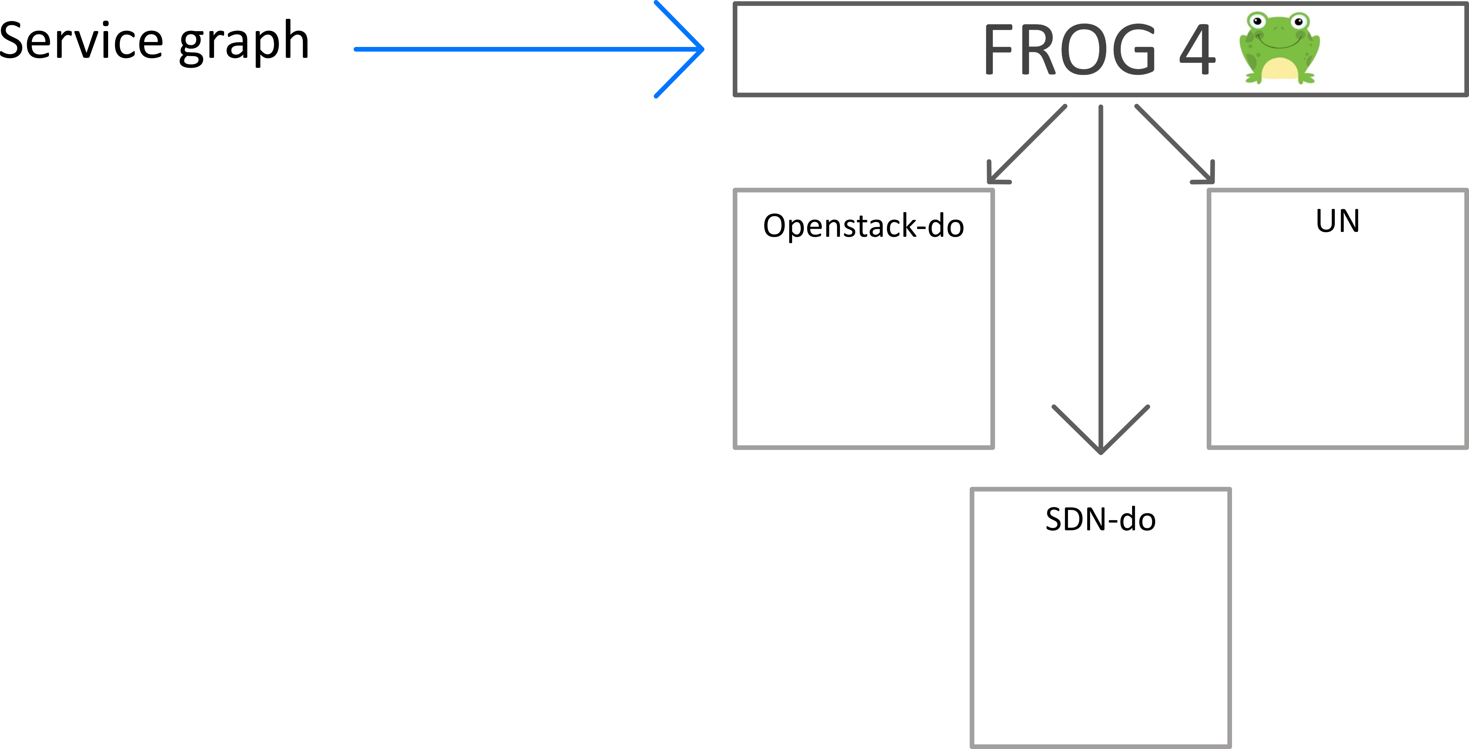
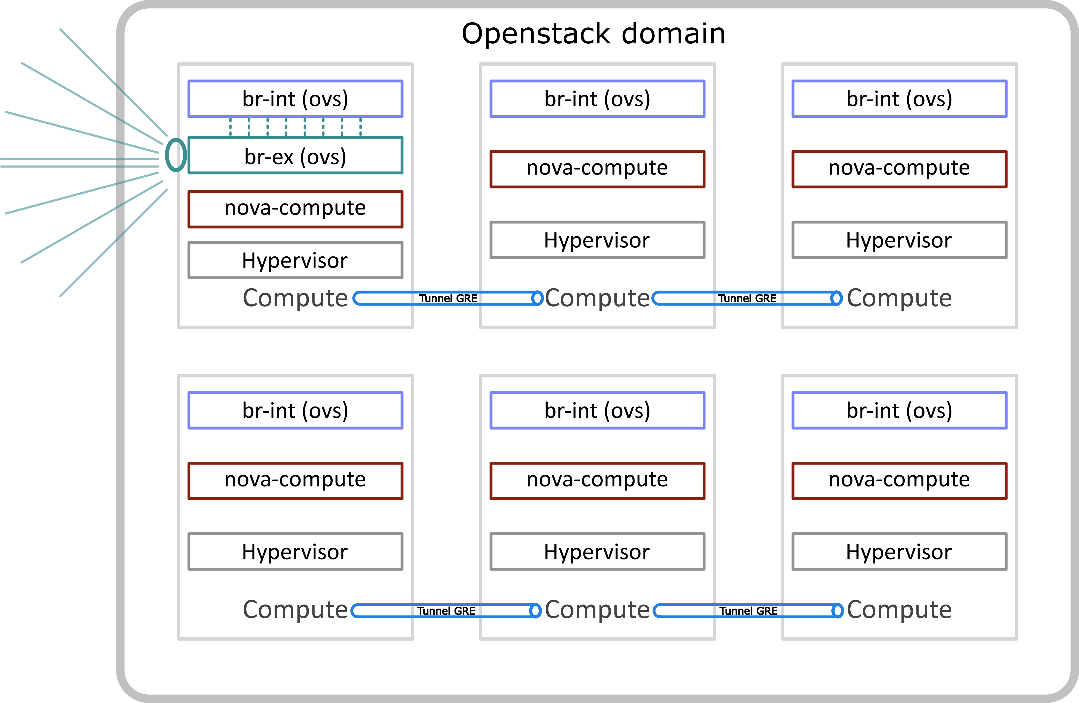
2/30
Politecnico of Turin
Master Degree in Computer Engineering
Overview
UN-do
Compute/Network

Slide 3
3/30
Politecnico of Turin
Master Degree in Computer Engineering
Objectives
Extension of the current Openstack Domain Orchestrator code to use ONOS as controller rather than Opendaylight
Supply support for creating tunnels from the outside of the Openstack domain right to the correct compute node
Supply support for multiple compute nodes environment

Slide 4



4/30
Politecnico of Turin
Master Degree in Computer Engineering
Tools and technology used

Slide 5
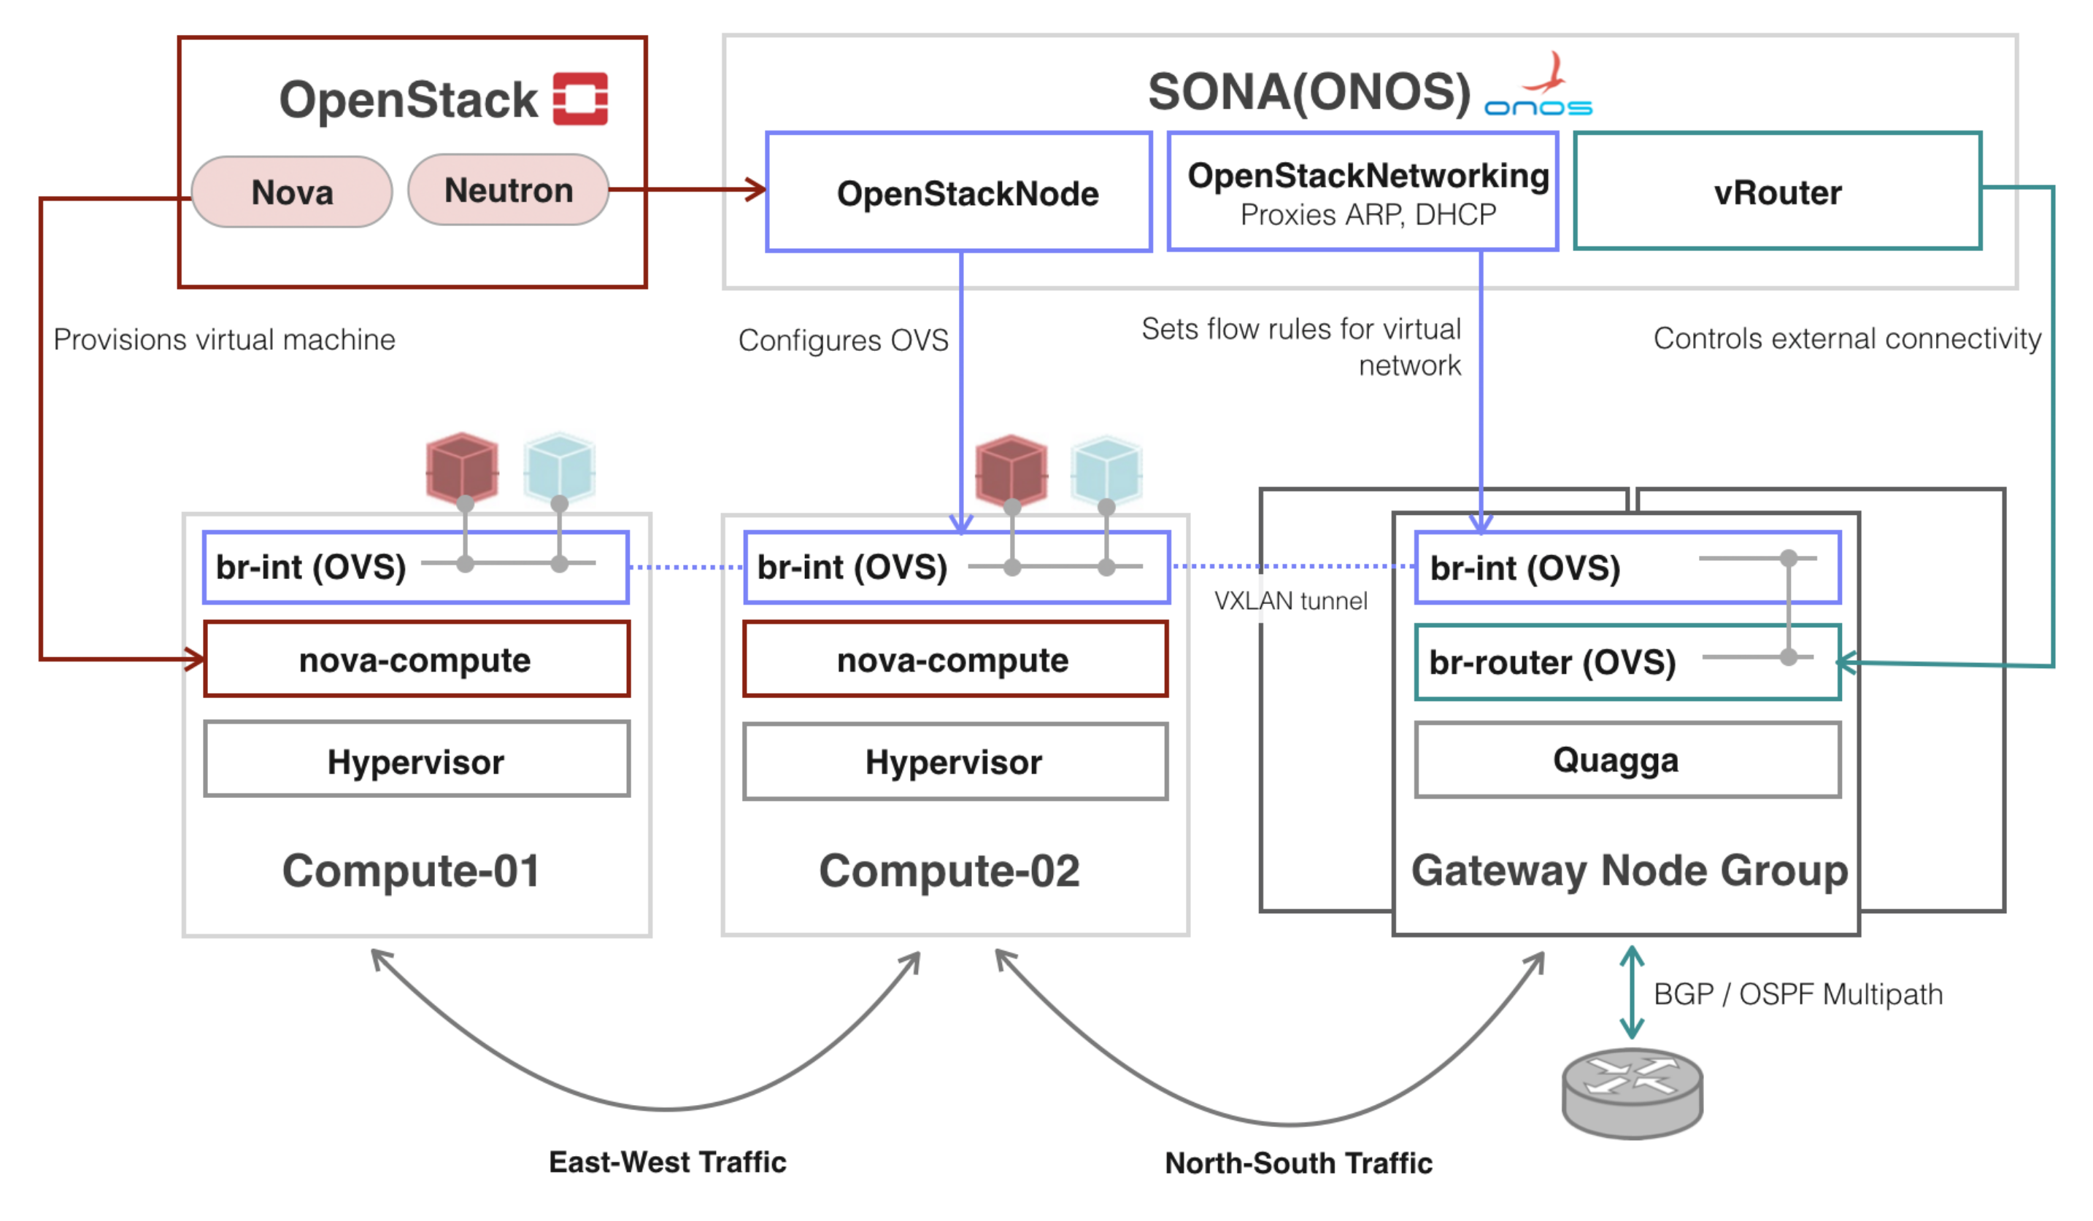
5/30
Politecnico of Turin
Master Degree in Computer Engineering
Tools and technology used
SONA (Simplified Overlay Network Architecture)
This is the default SONA architecture which has been
revised in this project to better accomplish the
related objectives

Slide 6
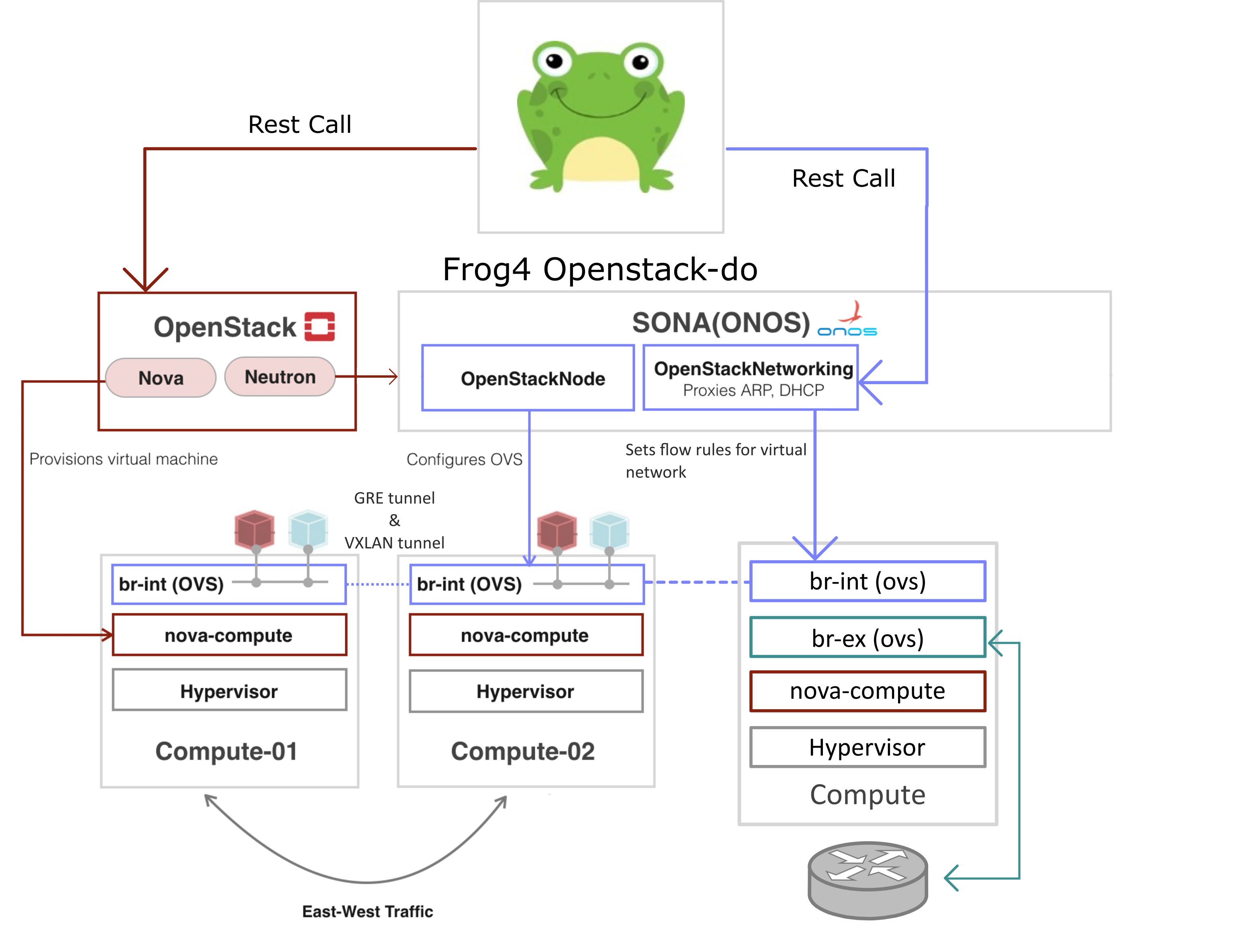
6/30
Politecnico of Turin
Master Degree in Computer Engineering
Current architecture
This architecture differs, from the previous one, in how it’s
handled the network node part. Here we have a network node,
in the previouse architecture we had a gateway node group which
use the vRouter app.
Compute/Network

Slide 7
7/30
Politecnico of Turin
Master Degree in Computer Engineering
Main troubles
Here several troubles encountered:
Use of the old Keystone 2.0 api
Sona guide not really clear at the beginning
Logical reorganization of the Openstack-do

Slide 8
8/30
Politecnico of Turin
Master Degree in Computer Engineering
Main contribute
An helpful contribute has been provided, within ONOS forum, about the first two troubles mentioned previously. I supplied some hints and fixes to solve that issues and to update the official SONA guide.
https://groups.google.com/a/onosproject.org/forum/#!topic/onos-discuss/xrK2mhQLz_U

Slide 9
9/30
Politecnico of Turin
Master Degree in Computer Engineering
Main Steps
The first objective is composed of 2 parts:
ONOS as network controller
Extension of the Openstack domain orchestrator code

Slide 10
10/30
Politecnico of Turin
Master Degree in Computer Engineering
ONOS as network controller
This first part is made up of 3 steps:
Substitute Opendaylight as network controller in favor of ONOS
Integrating ONOS with Openstack
Sona configuration

Slide 11
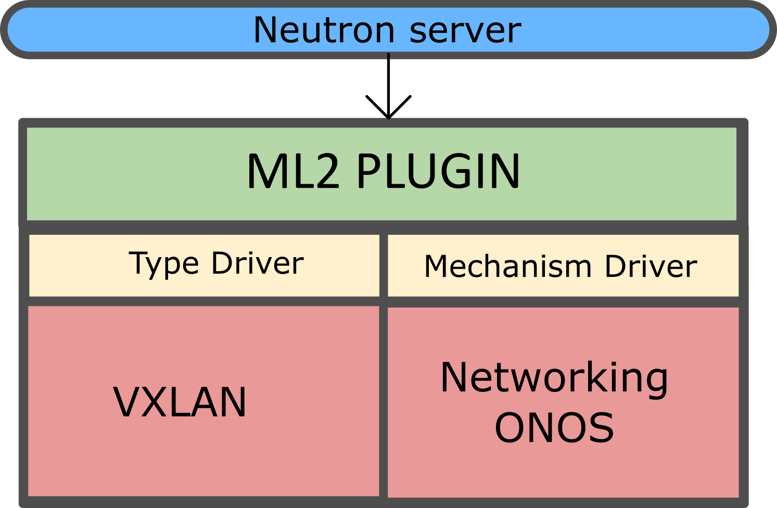
11/30
Politecnico of Turin
Master Degree in Computer Engineering
Integrating ONOS with Openstack
Main actor
Networking-ONOS
ML2 plugin Used by Neutron to steer the ML2 mechanism driver provided
by SONA
Type driver supported: only VXLAN
Warning for ONOS version <=1.9.0, which uses the old and deprecated Keystone 2.0 api.

Slide 12
12/30
Politecnico of Turin
Master Degree in Computer Engineering
SONA configuration
Basically it’s a set of applications (in this project vRouter app is not used) which could be grouped as follows:
OVSDB and openflow functionality
org.onosproject.drivers.ovsdb
org.onosproject.ovsdb-base
org.onosproject.openflow-base
Openstack node initialization
org.onosproject.openstacknode
org.onosproject.openstackinterface
Northbound ML2 interface:
org.onosproject.openstackswitching (DEPRECATED with ONOS 1.10)
org.onosproject.openstacknetworking
Extra application: OVSDB-Rest application
Implemented a new REST api to retrieve the BridgeID
Now support a multiple compute nodes configuration

Slide 13
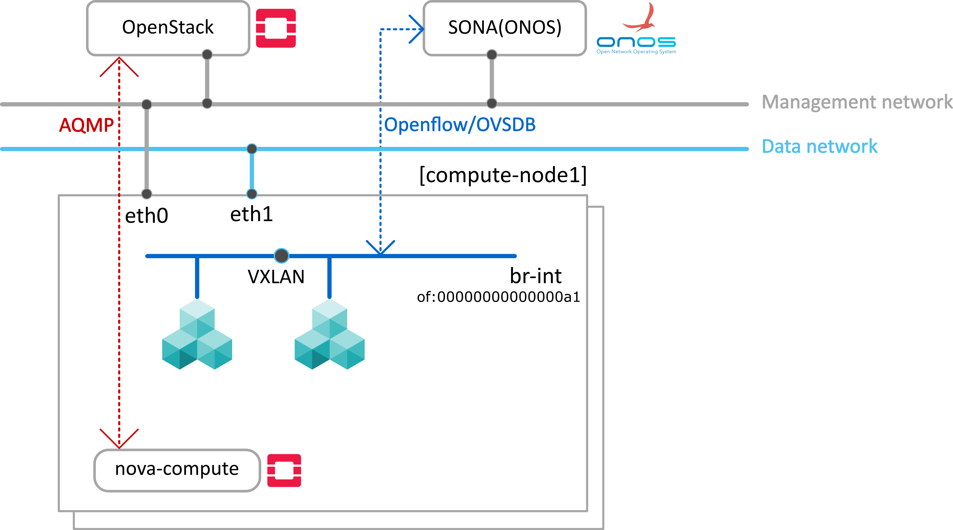
13/30
Politecnico of Turin
Master Degree in Computer Engineering
SONA configuration
Compute node description (usefull script provided to generate the configuration)
"nodes" : [
{
"hostname" : "compute-node",
"type" : "COMPUTE",
"managementIp" : "COMPUTE_NODE_IP",
"dataIp" : "COMPUTE_NODE_DATA_IP",
"integrationBridge" : "of:00000000000000a1"
}
]
"devices" : {
"of:00000000000000a1" : {
"basic" : {
"driver" : "sona"
}
}
}
VXLAN interface created
automatically by SONA

Slide 14
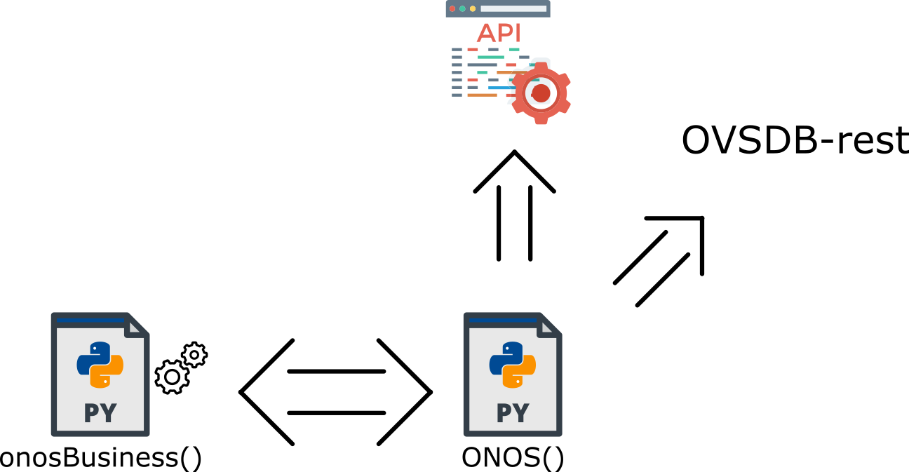
14/30
Politecnico of Turin
Master Degree in Computer Engineering
Openstack domain orchestrator code extension
Added new classes: onosBusiness and ONOS
The first provides business logic to handle REST calls towards ONOS
The latter realizes those REST calls through ONOS official api and OVSDB-rest application
This classes aim mainly to accomplish different goals:
Create/delete bridges
Add/delete ports
Add/delete patch ports
Add/delete GRE tunnel

Slide 15
15/30
Politecnico of Turin
Master Degree in Computer Engineering
Openstack domain orchestrator code extension
Flowrules:
Flowrules are associated to an appID(org.onosproject.ovsdbrest here), useful to identify which application
may be misbehaving or consuming many resources.
For the flowrules has been choosen a priority >= 50000, to let the generated flows work without interfer
with the flows generated by ONOS, up to 65535
(A useful script to delete all the flows deployed by the Openstack domain orchestrator, has been provided)
The controller class has been extended to support multiple compute nodes environment
VNF-VNF flow, Endpoint-VNF flow and viceversa

Slide 16
16/30
Politecnico of Turin
Master Degree in Computer Engineering
Openstack-do interactions
Three main interactions:
1. Authentication through Keystone API
2.1. Endpoint and Resources instantiation (Networks)
2.2. Resources instantiation (VNFs and relative ports)
3 FlowRules generation

Slide 17
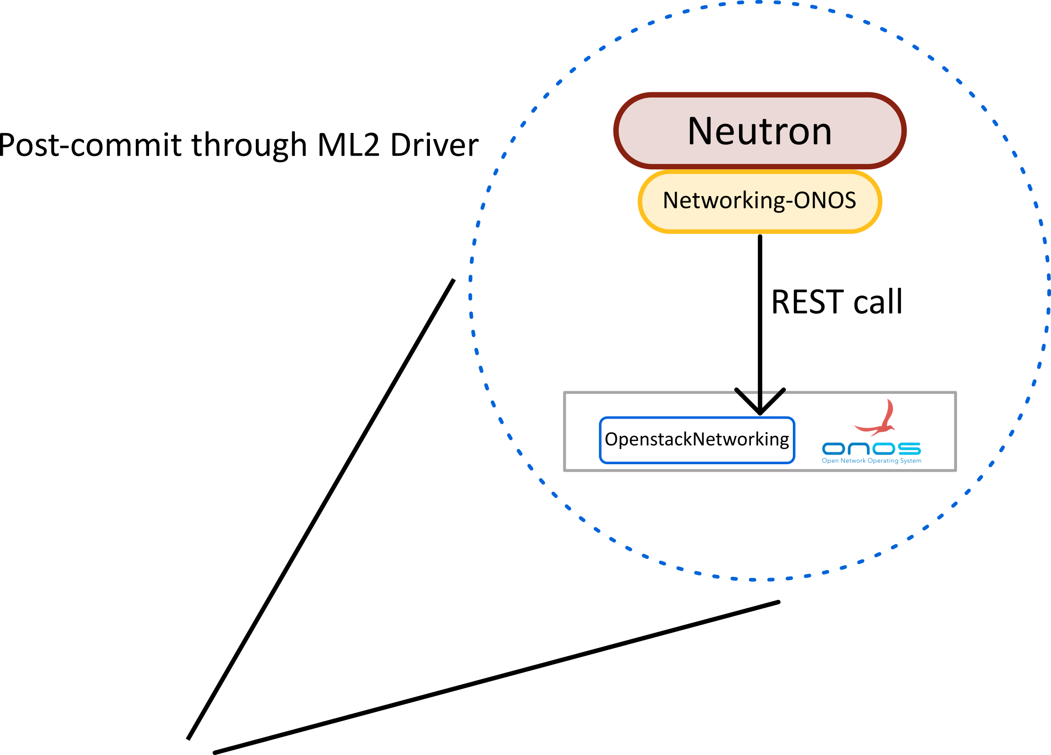
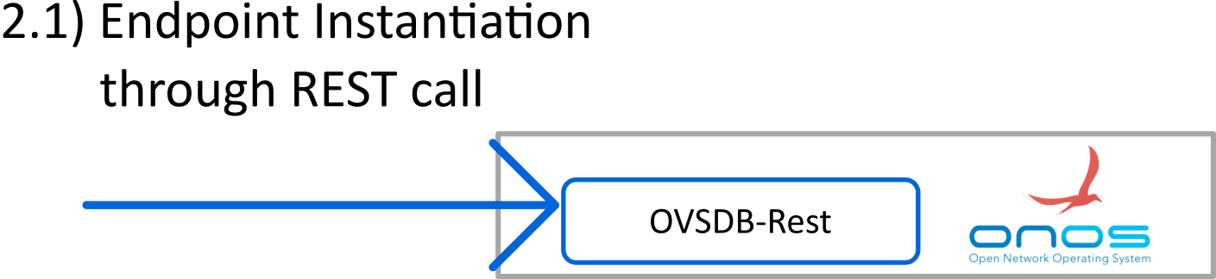
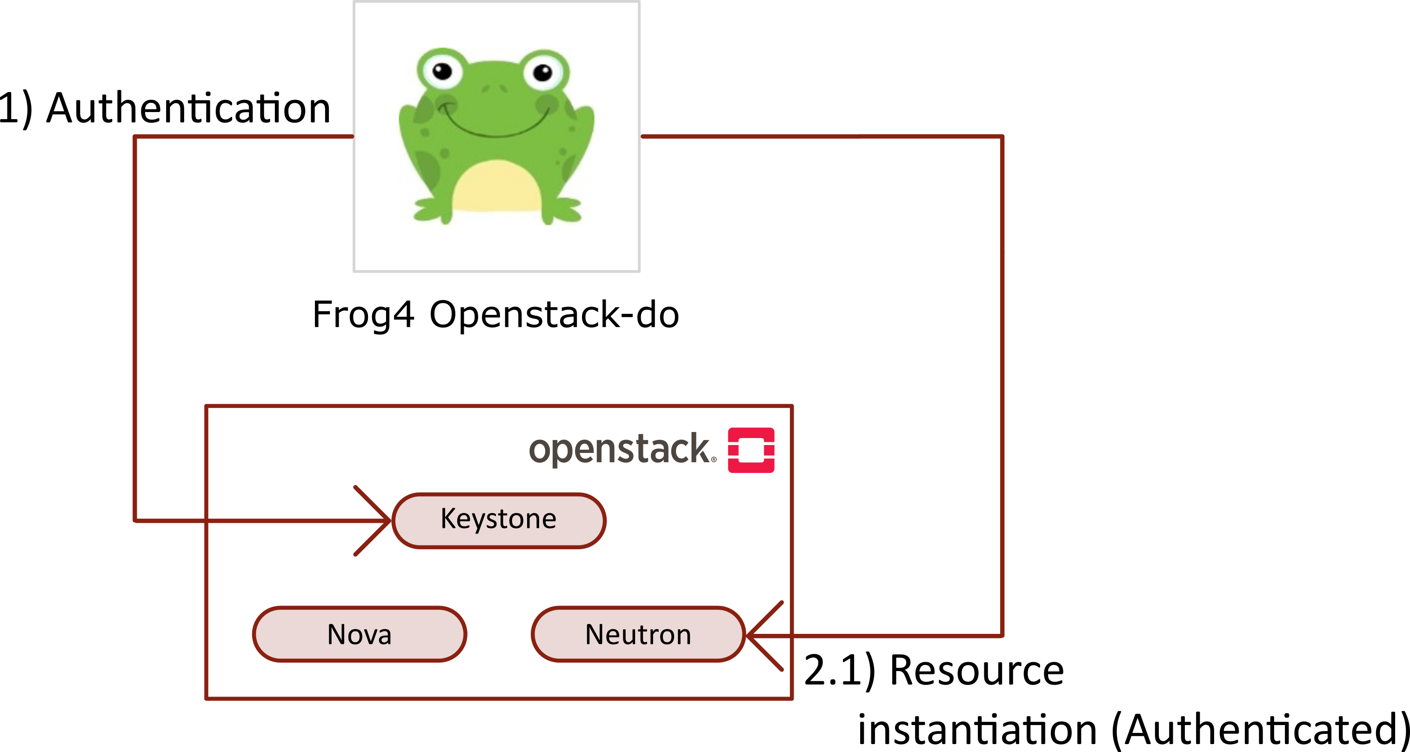
17/30
Politecnico of Turin
Master Degree in Computer Engineering
Openstack-do interactions

Slide 18
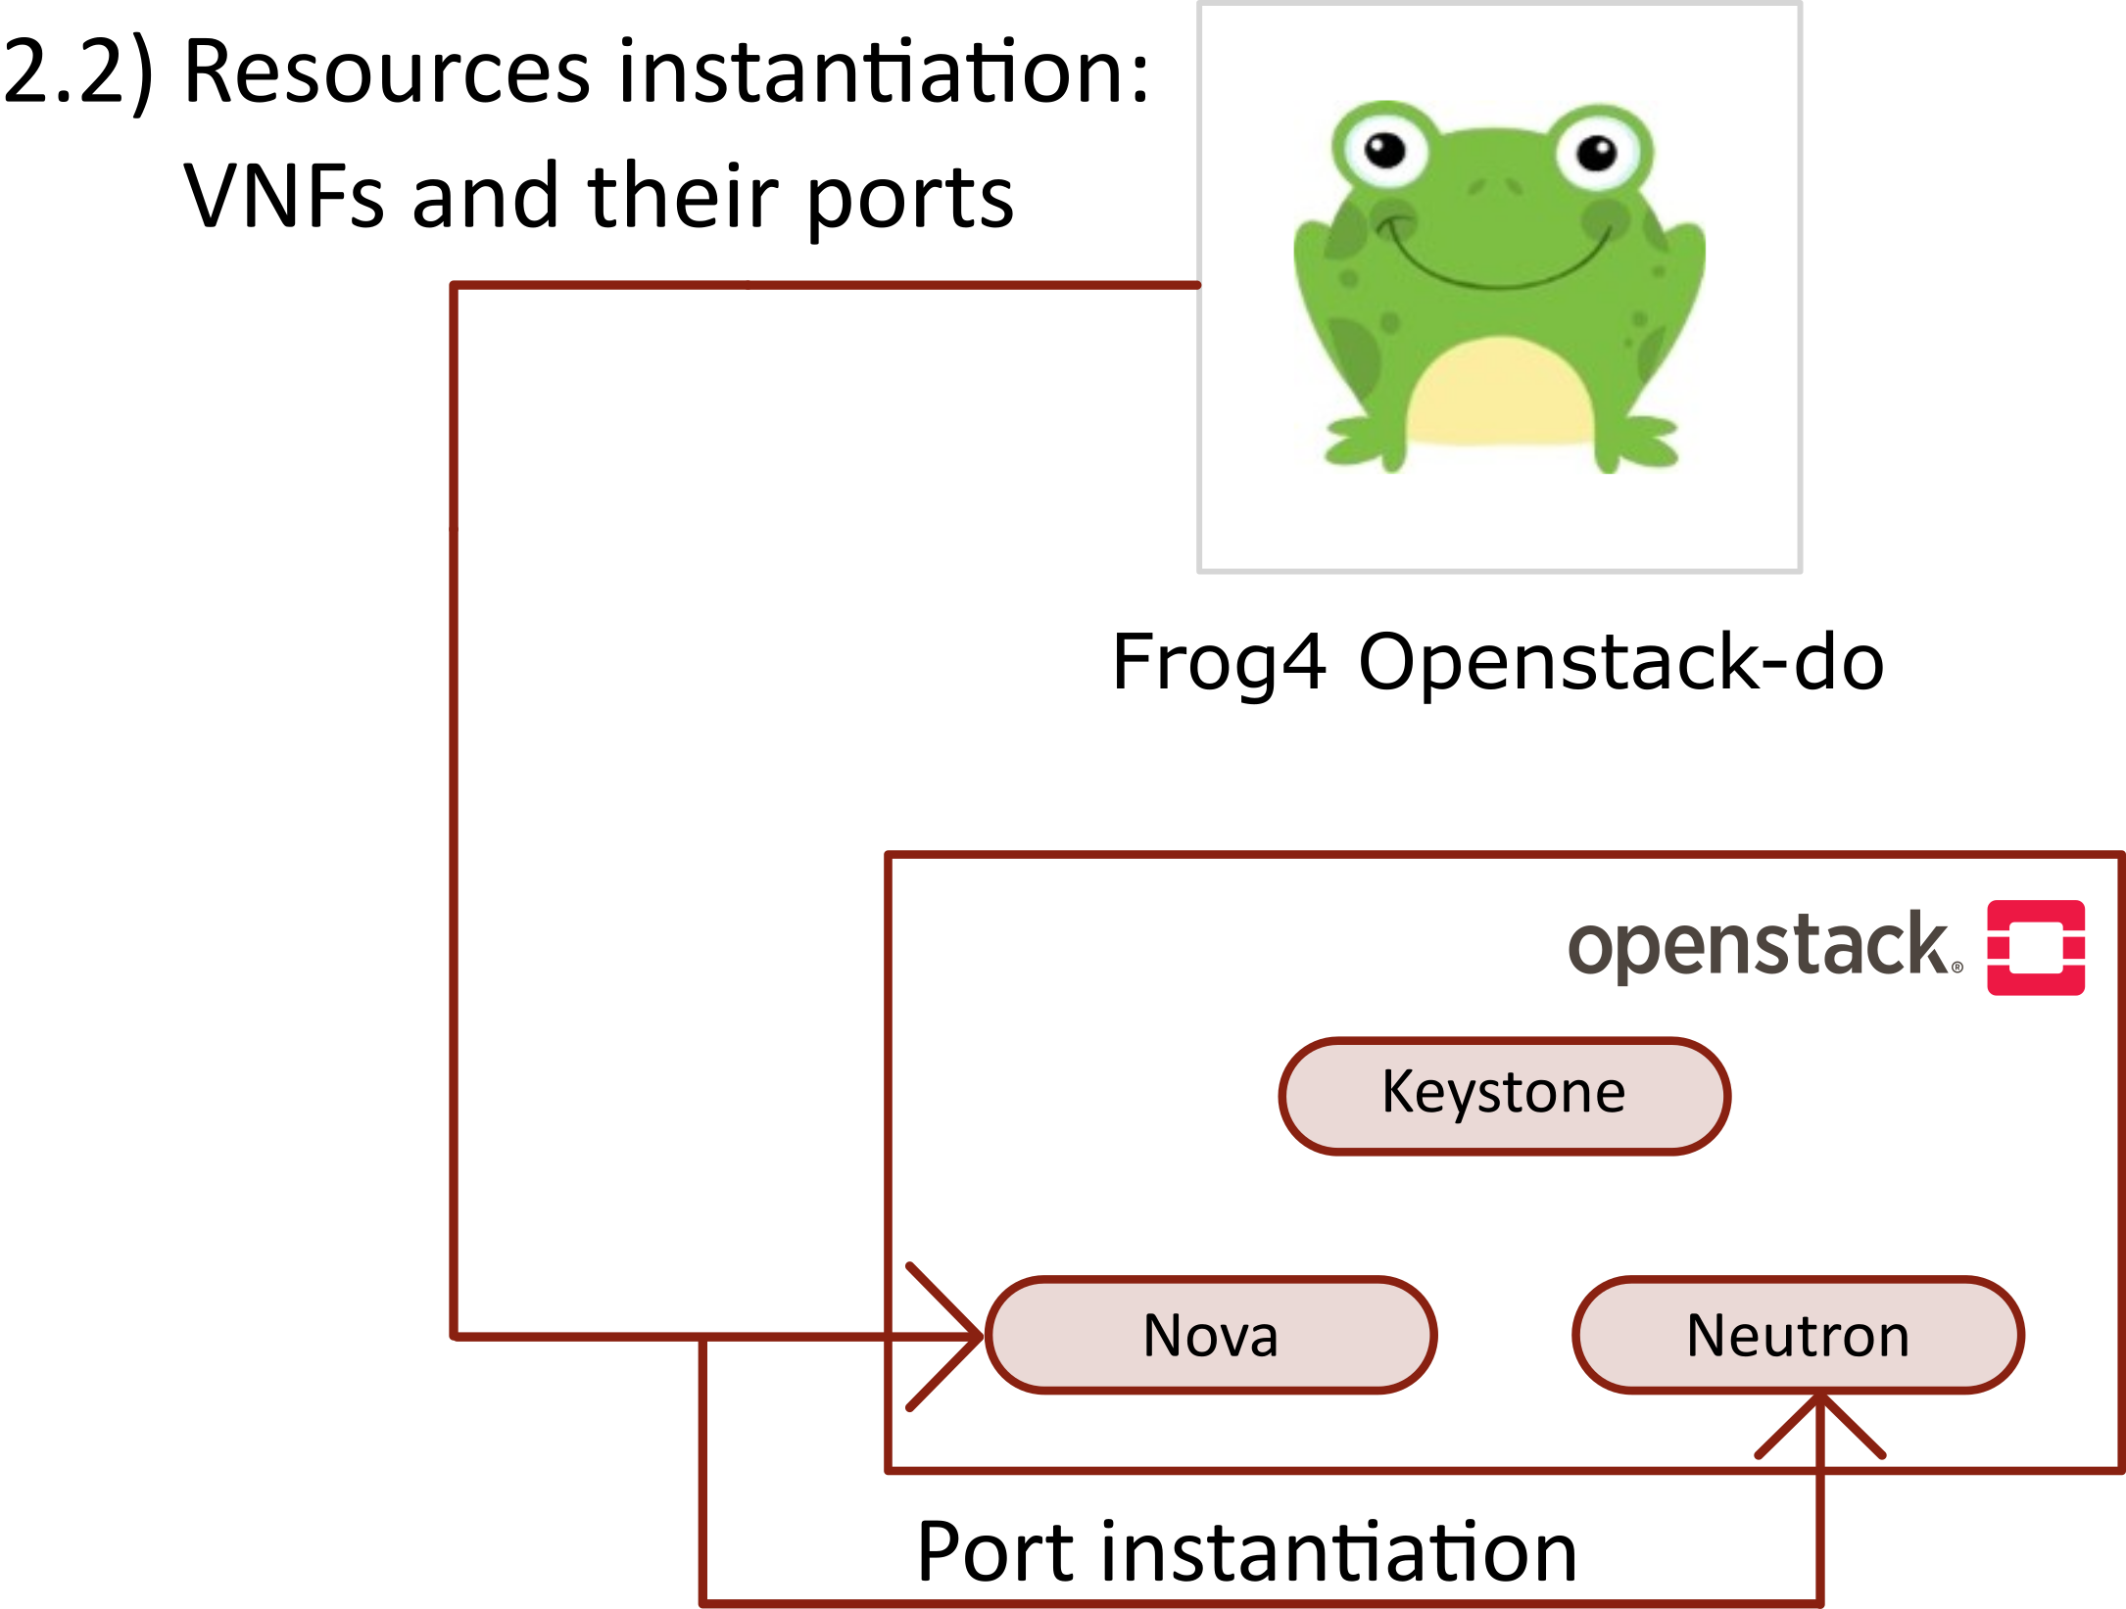
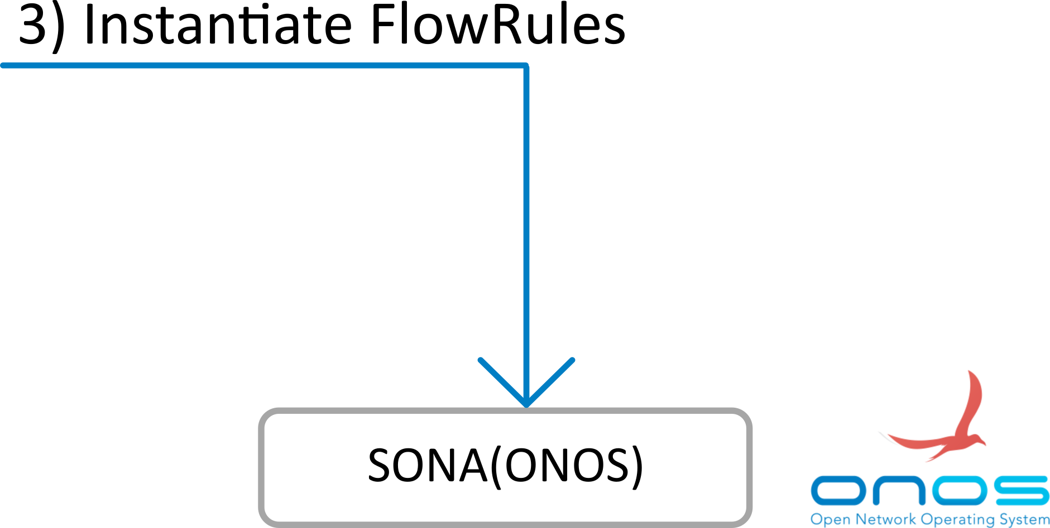
18/30
Politecnico of Turin
Master Degree in Computer Engineering
Openstack-do interactions

Slide 19
19/30
Politecnico of Turin
Master Degree in Computer Engineering
FlowRules format
" treatment " :{
"instructions": [
{
"type": "OUTPUT",
"port": "CONTROLLER"
}
]
},
"selector": {
"criteria": [
{
"type": "IN_PORT",
"port": "1"
}
]
}
{
"priority": 500000,
"timeout": 0,
"isPermanent": true,
"deviceId": "of:0000000000000001",
}

Slide 20
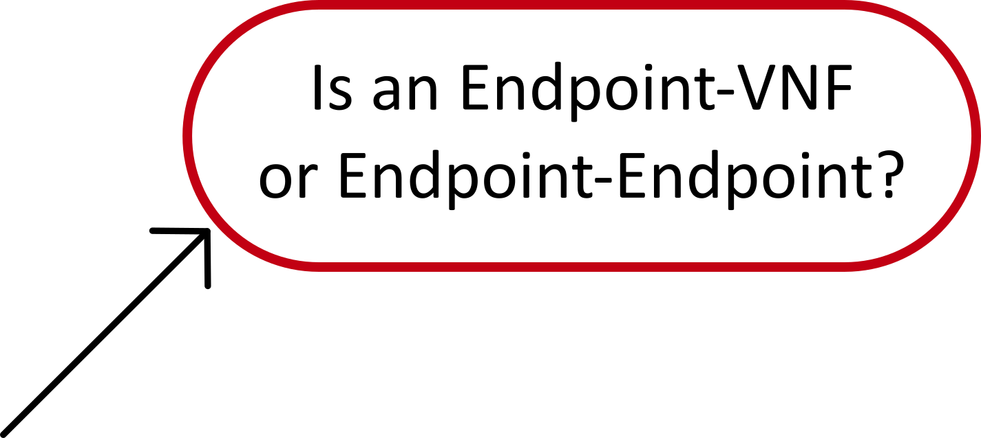
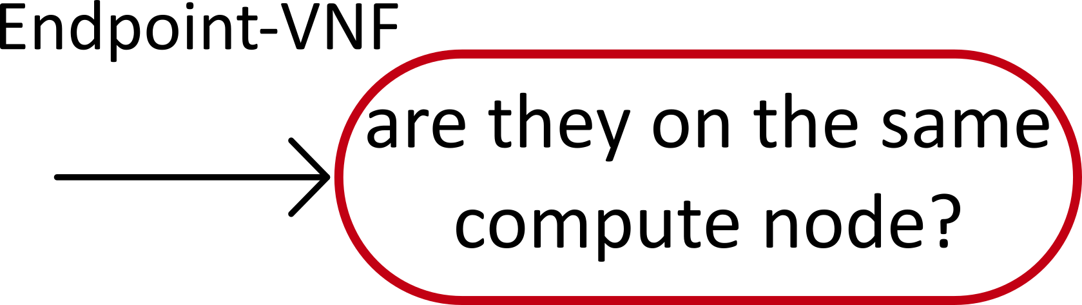
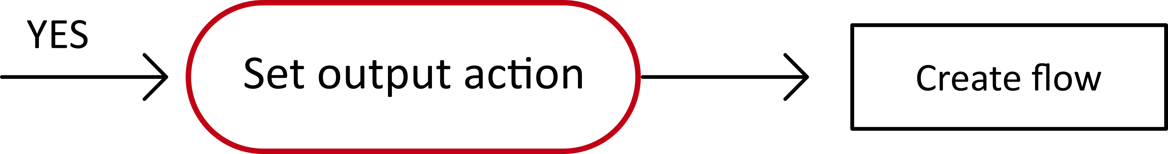
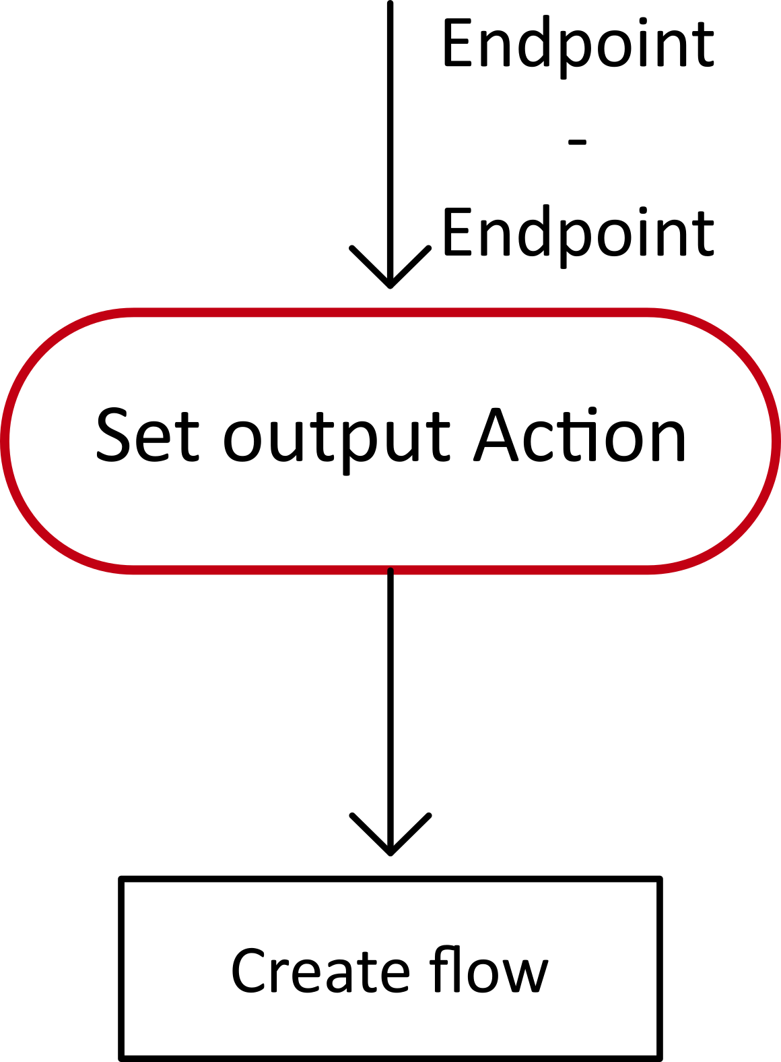
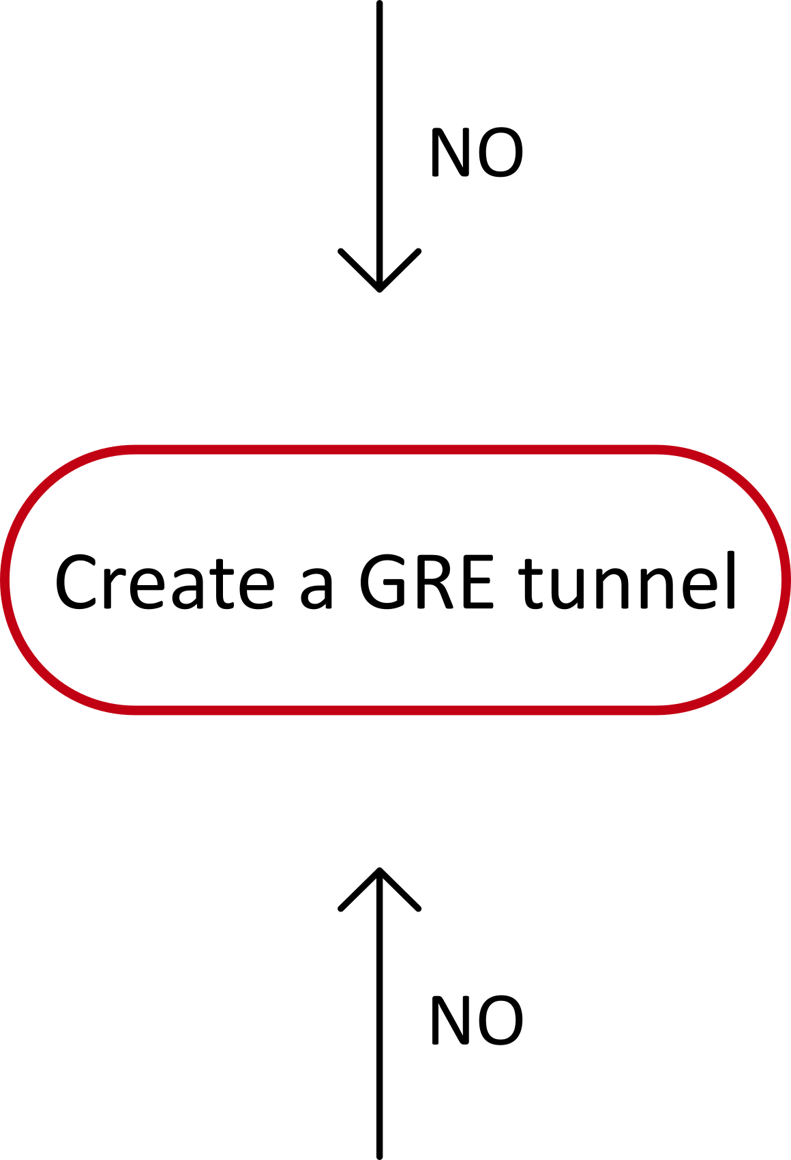
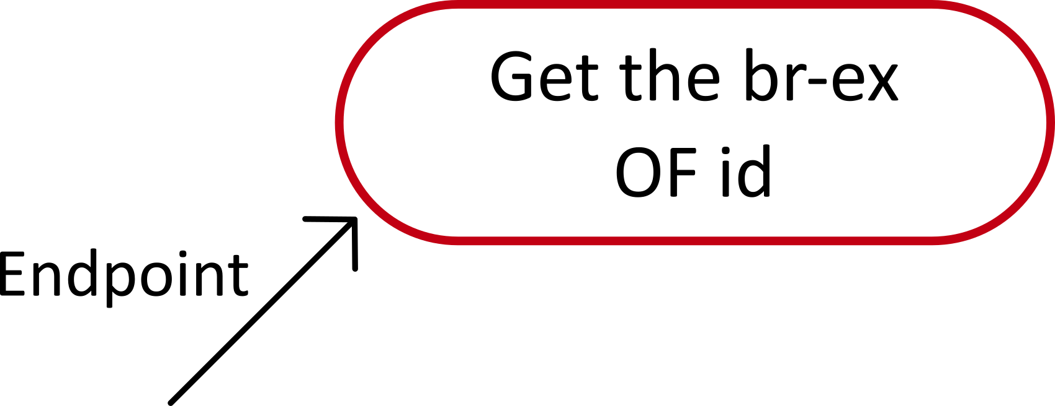
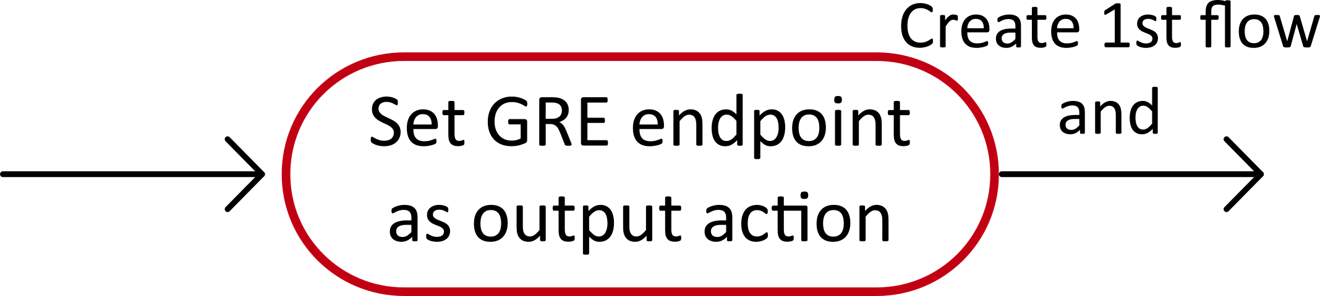
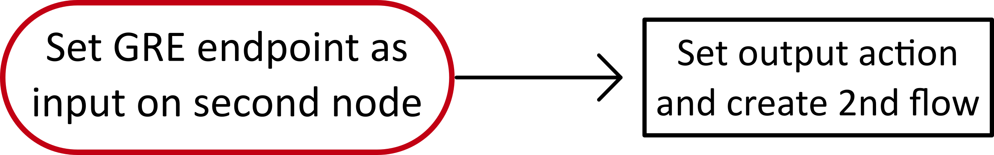

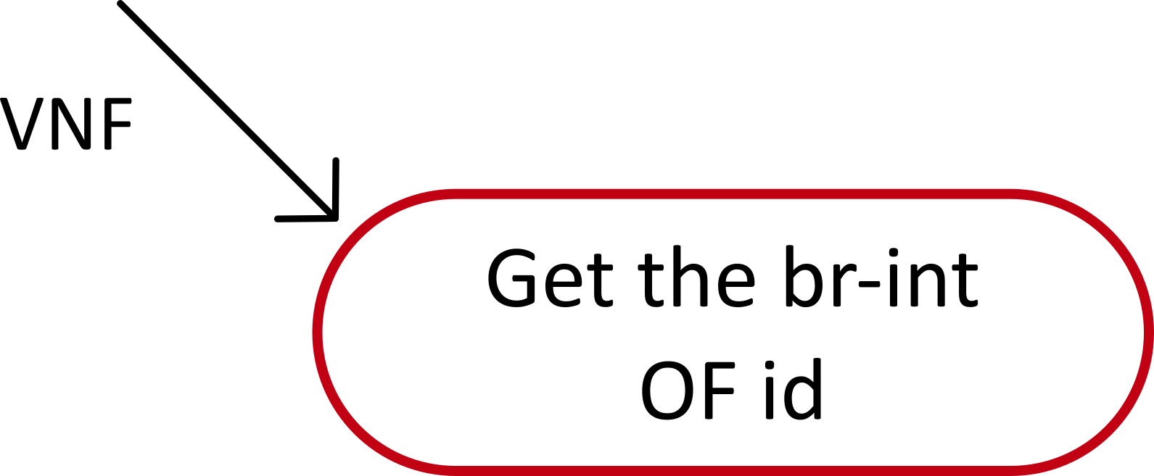
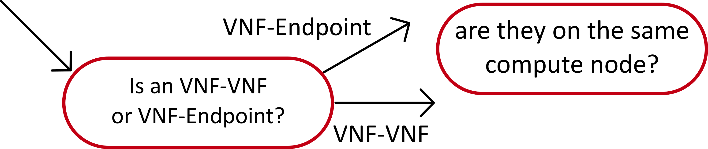
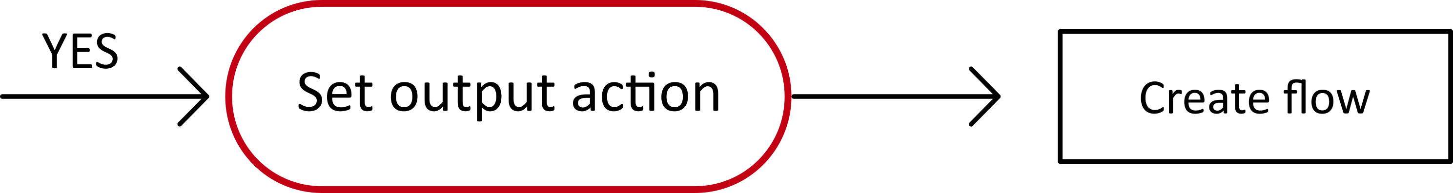
20/30
Politecnico of Turin
Master Degree in Computer Engineering
Check onos management address which is the same of the ovs manager
FlowRules Instantiation
*
*
*

Slide 21
21/30
Politecnico of Turin
Master Degree in Computer Engineering
Known Issue
It is needed to deploy flows that steer traffic through a transparent VNF. That is due to some flows, related to security group, requested by Neutron. This flows force traffic exits from a VNF port must have as src MAC address, the same assigned to the VNF exit port.

Slide 22
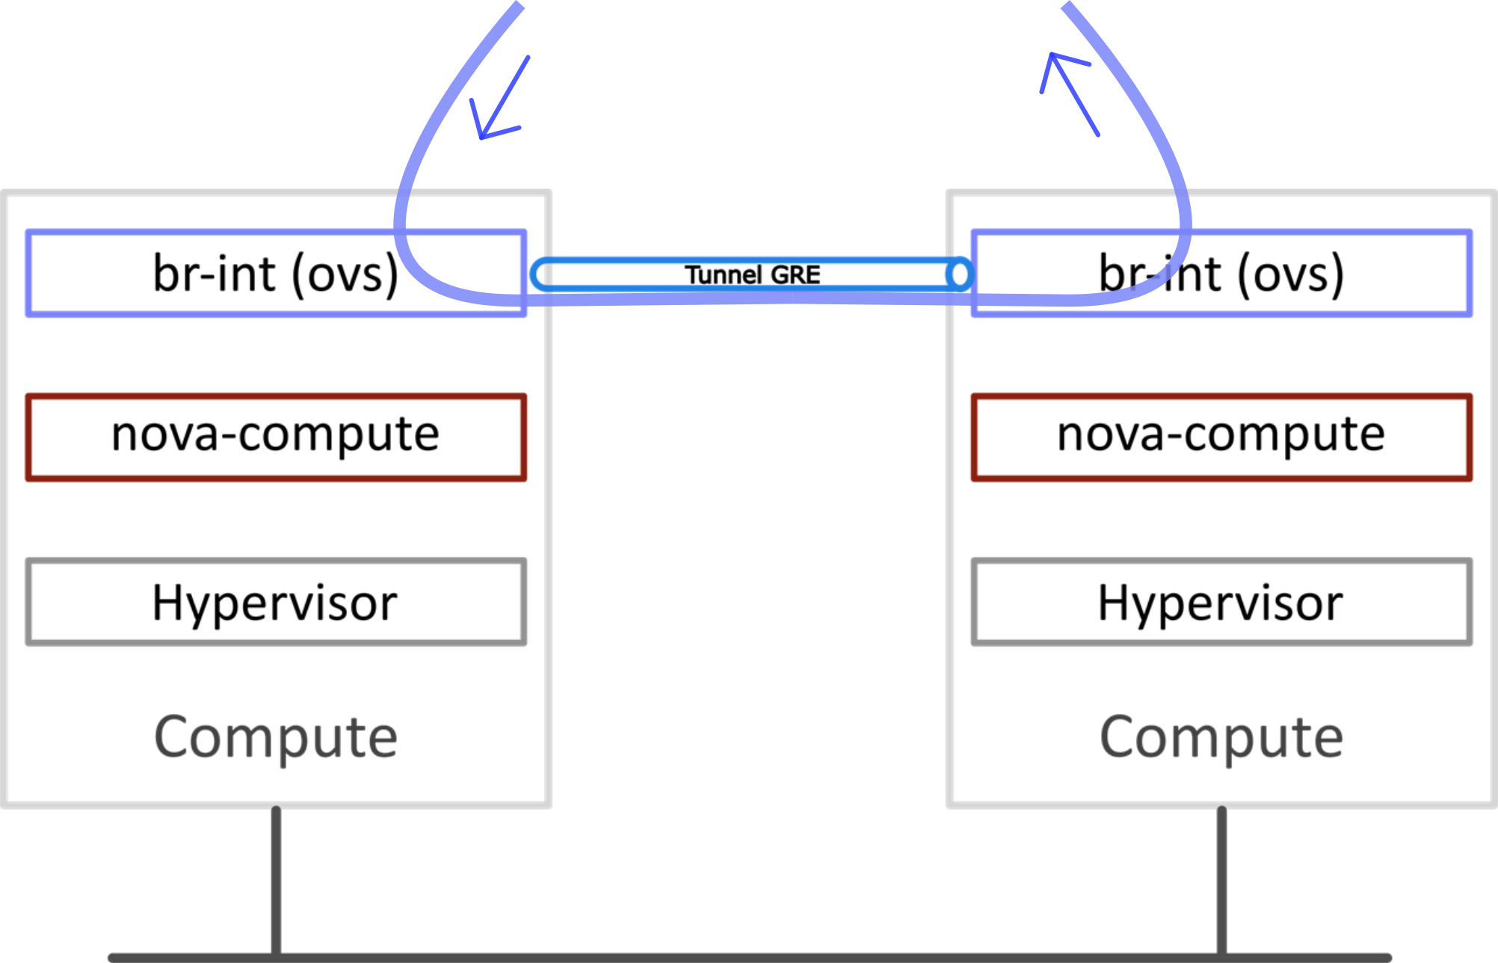
22/30
Politecnico of Turin
Master Degree in Computer Engineering
Final Result

Slide 23
23/30
Politecnico of Turin
Master Degree in Computer Engineering
Orchestrator reorganization
Some improvements and logical reorganization
User switch deleted. Only one switch for ingoing and outgoing traffic (br-ex)
Support for multiple nodes environment
Support for tunnel coming from the outside of the Openstack domain

Slide 24
24/30
Politecnico of Turin
Master Degree in Computer Engineering
Endpoint handled
Managament of four different kind of Endpoints:
Interface, created on the exit bridge
GRE, created on the exit switch and also code generated to enable the multiple
Compute nodes environment
VLAN, created on the integration bridge
Internal, created on the internal bridge

Slide 25
25/30
Politecnico of Turin
Master Degree in Computer Engineering
Second and third objective
GRE-Endpoints
Patch ports between br-int and br-ex
GRE-Endpoint on the br-ex
Tunnel GRE between br-int on different
compute nodes
Compute/Network

Slide 26
26/30
Politecnico of Turin
Master Degree in Computer Engineering
Final architecture
* GRE tunnel for communication between br-int
VXLAN tunnel used by SONA for VMs communication
Compute/Network

Slide 27
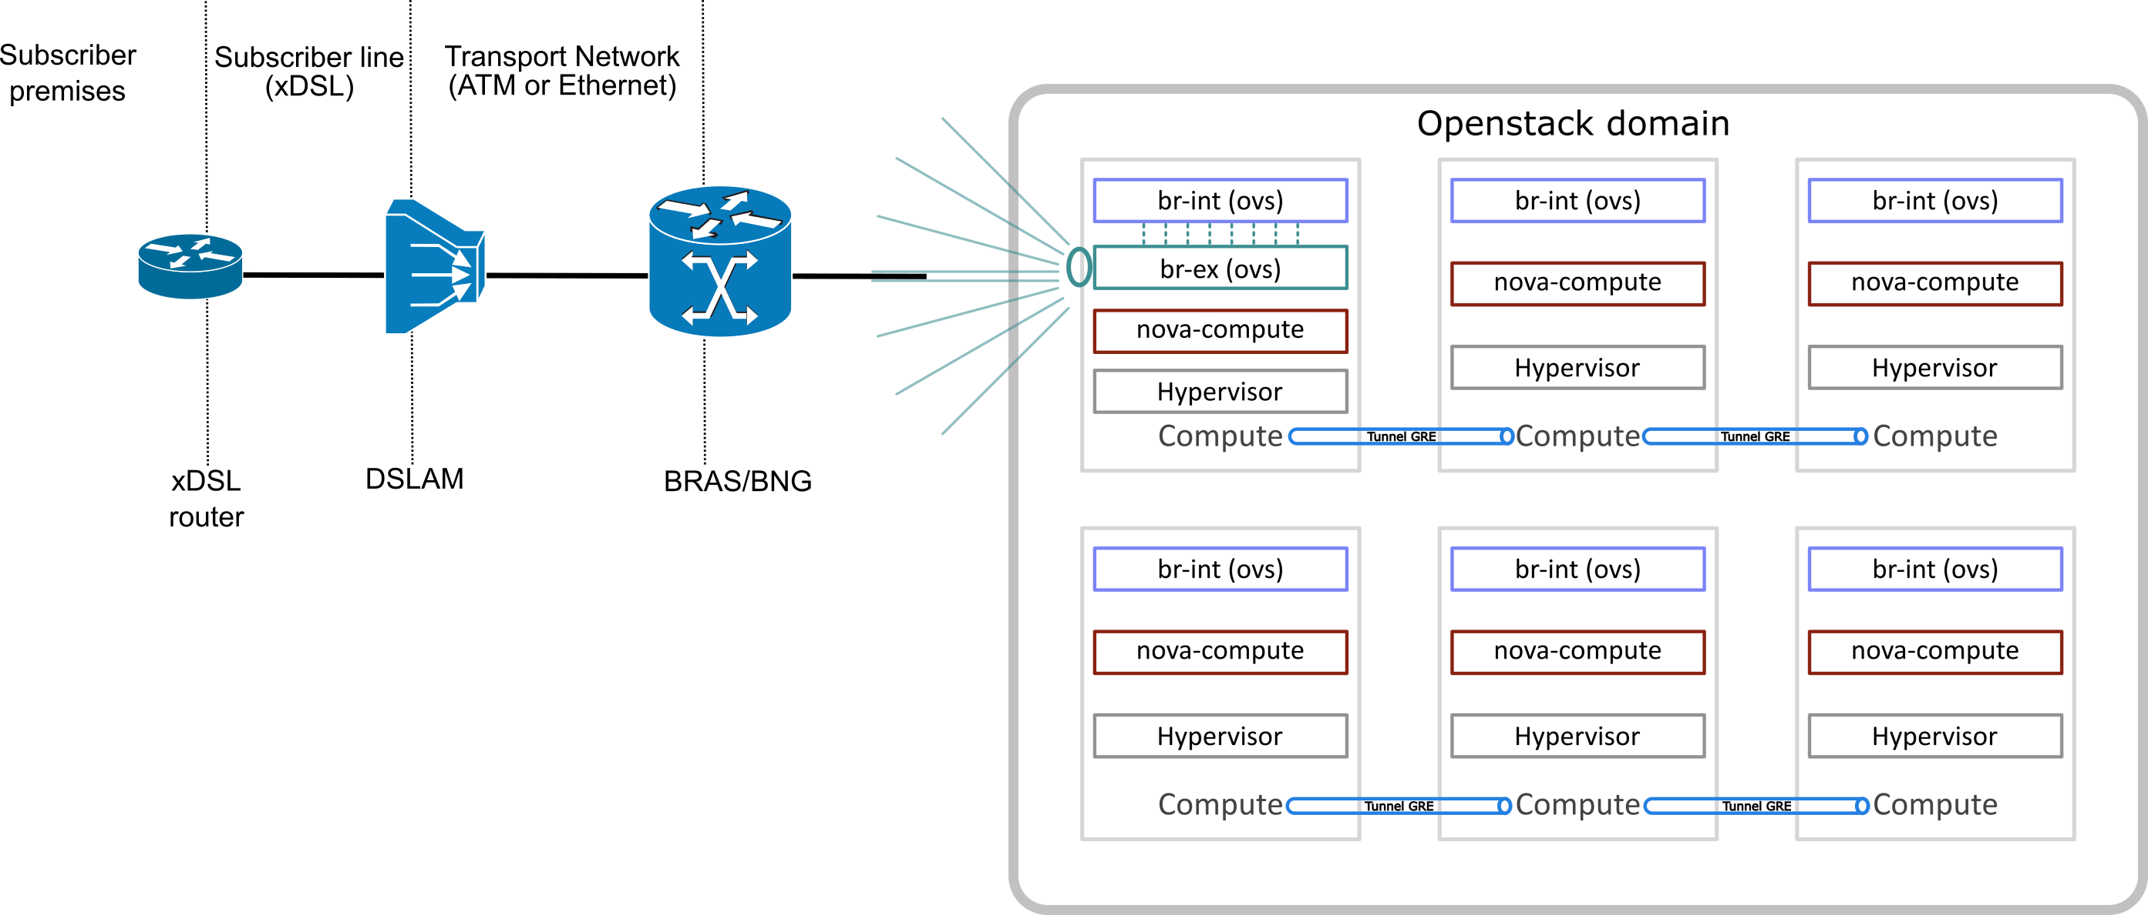
27/30
Politecnico of Turin
Master Degree in Computer Engineering
Possible application
Compute/Network
Telco domain

Slide 28
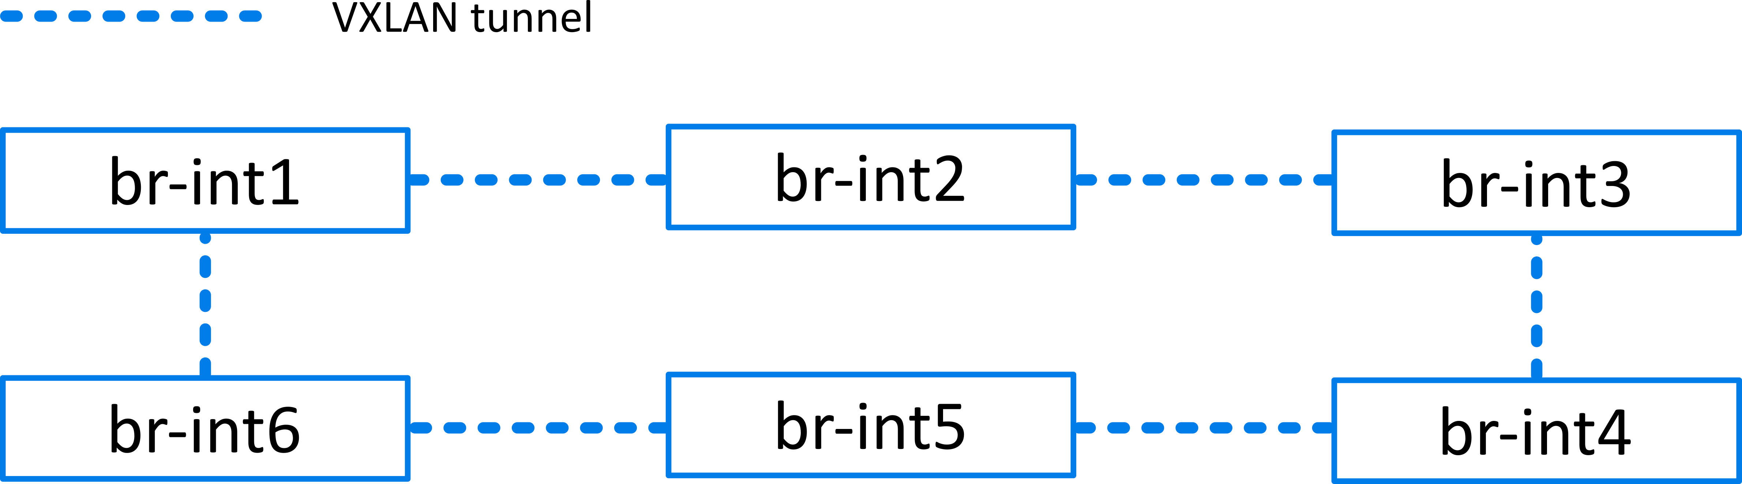
28/30
Politecnico of Turin
Master Degree in Computer Engineering
A more scalable alternative
Tunnel GRE everywhere… Solution?
Use the available VXLAN subsystem
Useful manual: man ovs-vswitchd.conf.db -> Tunnel Options
Thread opened: https://groups.google.com/a/onosproject.org/forum/m/#!topic/onos-discuss/T89D-PEtCqA

Slide 29
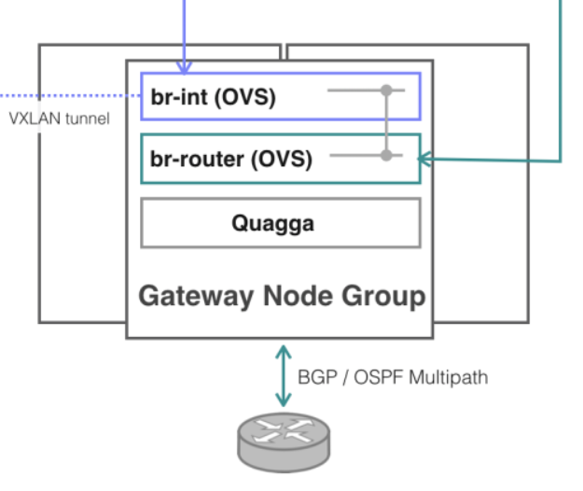
29/30
Politecnico of Turin
Master Degree in Computer Engineering
Another scalable alternative
Multiple Gateway nodes solution:
BGP/OSPF multipath load balancing with Quagga
HAProxy support
More reliability

Slide 30
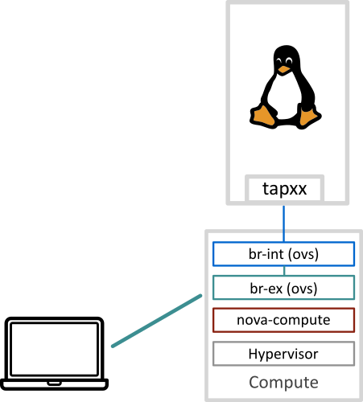
30/30
Politecnico of Turin
Master Degree in Computer Engineering
Validation
Endpoint – VNF flow
Endpoint – Transparent VNF – VNF
Endpoint – VNF (with VNF on a different compute node)
Compute/Network

Slide 31
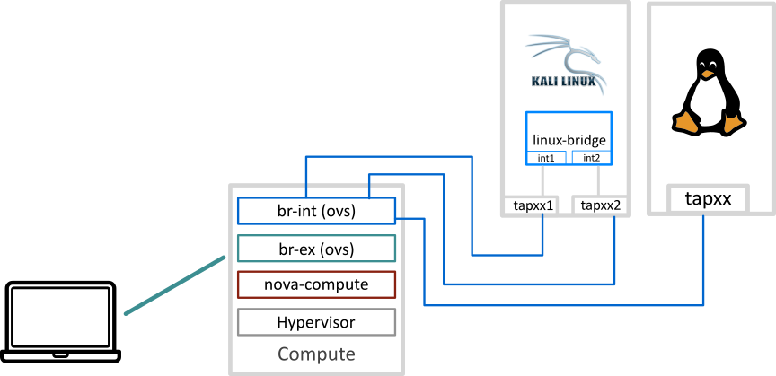
31/30
Politecnico of Turin
Master Degree in Computer Engineering
Validation
2. Endpoint – Transparent VNF – VNF
Compute/Network

Slide 32
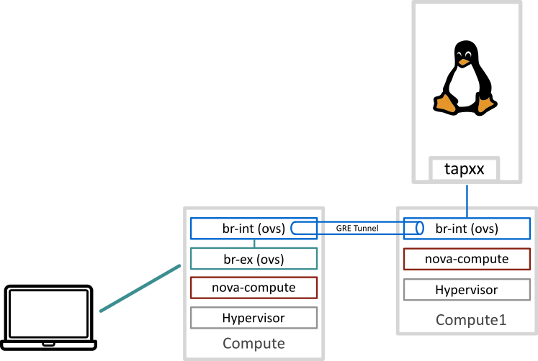
32/30
Politecnico of Turin
Master Degree in Computer Engineering
Validation
3. Endpoint – VNF (with VNF on a different compute node)
Compute/Network

